Slide 1
Is it possible to predict car rating based on its technical characteristics and user reviews?
MACHINE LEARNING
Lior Vaisman

Slide 2

The motivation behind my project
Car’s rating is very popular among a lot of people due to large verity of options.
I want to gather data from the web that will be useful for car manufacture to predict the rating of new cars by parameters that I’m thinking is the most relevant .
We can't ignore that sometimes people are buying with there heart and not baste on proper knowledge.

Slide 3
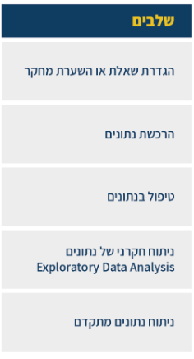

Steps

Slide 4
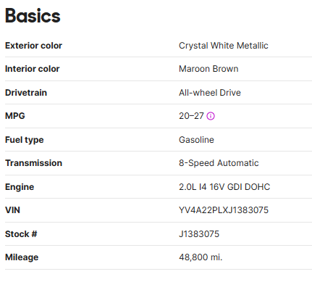
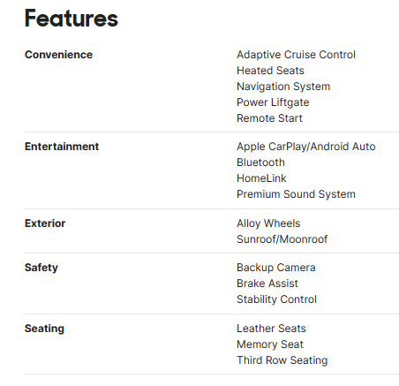
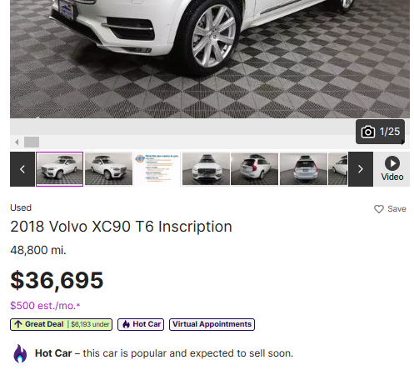
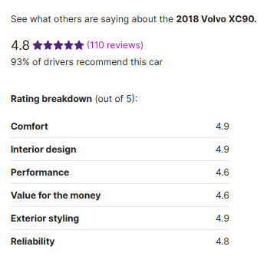
I based my data from : www.cars.com
The site contains over 500,000 cars for sale.
providing general information about the car.
let people post reviews about there car.

Slide 5

Import data
Full car name
car brand
price
Average score
Amount of reviews
Exterior_color
Interior_color
Drivetrain
mpg
Fuel type
Transmission
Year of production
Engine size
Mileage
Number of fitches

Slide 6

Cleaning data prosses
After data enquired from web-sites to data frame there is sometimes issue with the data.
I hade also that problem with multiple fields
In column “price ”-> the data was with the $ sign, witch I needed to remove .
In column “reviews”-> the data was with the word “reviews” and with tags which was removed.
Ads that didn’t had the information that I couldn’t fill, was removed.

Slide 7


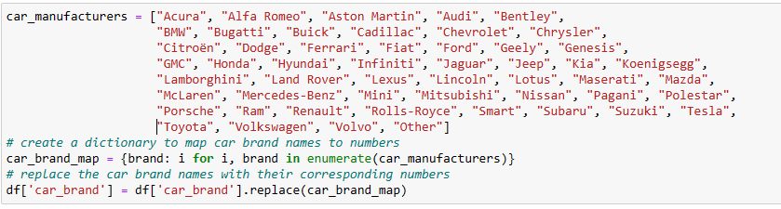
Classification
In some columns I decided to use “bins” as classification groups for columns data as :
Miles , price …
By dividing the data into discrete groups, bins help to simplify and summarize the data, making it easier to analyze and visualize patterns and trends.

Slide 8

seaborn
pie
visualization of data
heatmap

Slide 9
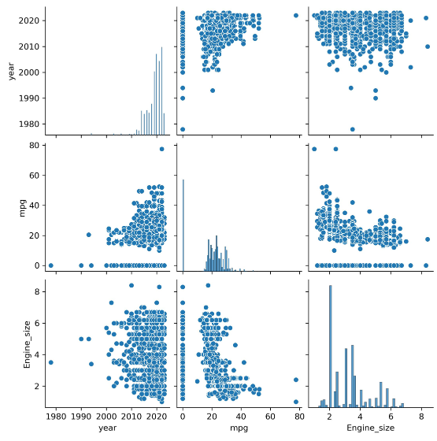
Scatter plot is a function in python data visualization library seaborn. Ut used to create scatter plot between two numerical variables.

Slide 10
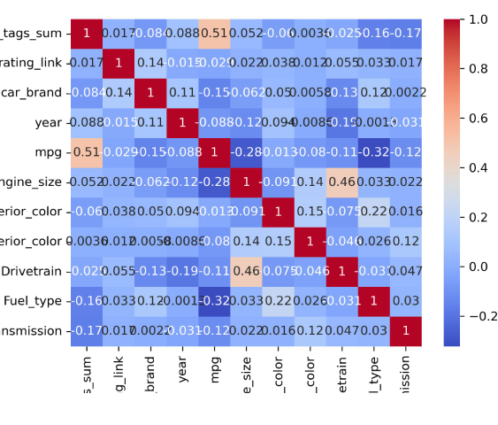
Seaborn heatmap with a correlation matrix is a graphical representation of the pairwise correlation coefficients between variables in a dataset, displayed as a heatmap. The heatmap provides a color-coded visual representation of the correlation values, where each cell in the heatmap corresponds to the correlation coefficient between two variables.

Slide 11

Machine learning
In my project the “label” was already in my data-frame, at the beginning I tried using “linear regression” , Aldo i didn’t know which parameters going to affect the result, I build a function that check all the possible combinations for me.
The best result for “R square” was 0.12, that wasn’t good.

Slide 12

DecisionTreeRegressor
DecisionTreeRegressor is a machine learning algorithm that is used for regression tasks. It belongs to the family of decision tree algorithms, which build a model in the form of a tree structure. The tree is constructed by recursively partitioning the data into subsets based on the values of input features, with the goal of minimizing the variance of the target variable within each partition.
Using DecisionTreeRegressor as machine learning algorithm, it produced better result
Features: ['rating_link', 'price', 'Drivetrain', 'Fuel_type', 'Mileage['
Mean squared error: 0.01
Coefficient of determination (R^2)☺ 0.31

Slide 13
Personal opinion
Car’s are not always reviewed equally by different people, the same car can be rated completely different.
In my project I took prechosen to avoid comparing 1 person rating 5 satrs vs. 800 rating 5 stars.
Many parameters like pries and area of living can affect the choice people take regarding what car they buy and not necessarily the ultimate car for them, witch can affect rating.

Slide 14
The end

